Slide 1

Business Analytics Nanodegree
Project 2: NYSE Data Project
Ammar Bahasan

Slide 2
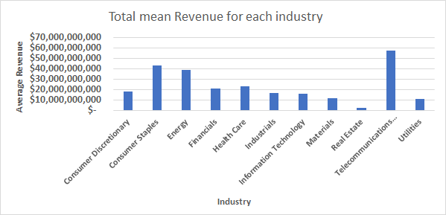
Total mean Revenue for each sector
<visualization or summary statistics used for finding>
The Telecommunications sector has highest average total revenue by far from the rest with mean of $57,537,392,650 . While the rest of the sector fell behind. the consumer Staples came second with mean of $43,407,926,144

Slide 3
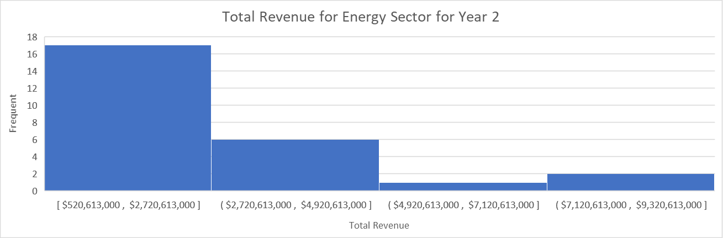
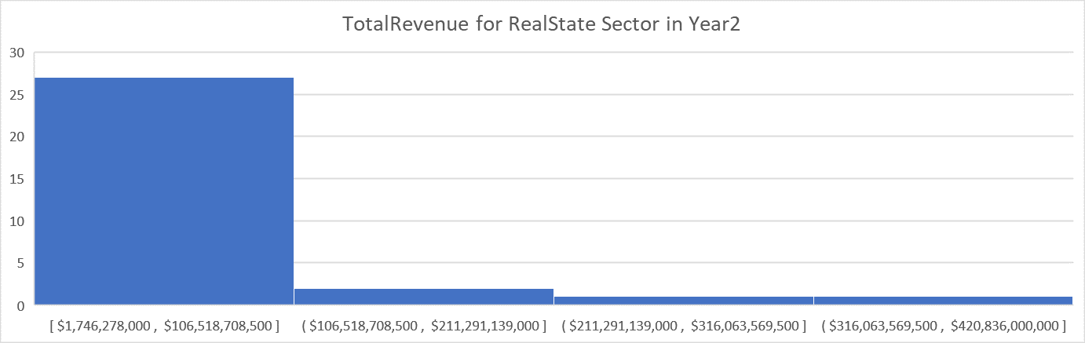
How does the revenue vary from Real state and energy ? Is the revenue similar is each stock in the industry ?
<visualization or summary statistics used for finding>
The Revenue is very different between the two industry in year 2.
Both distribution are right skewed (mean>median)
The mean in Real state is $44,065,932,903 while it’s only $2,375,729,308 in the energy. The standerd for Real state is $87,598,693,146 and only $1,872,814,417 in the Energy , which means the energy sector is more stable, the value are not very spread and maybe investing in such stocks will be a good idea and have a very low risk.
There are 5 stocks in Real State had a total revenue above(100B)
The range in Real State is $419,089,722,000 which tells us the the data is widely spread , while it’s only $6,733,387,000 in the Enegry Sector .

